Slide 1
First Class Levers adapted from Brain Pop

Slide 2
Levers allow us to move things more easily by magnifying our efforts.

Slide 3
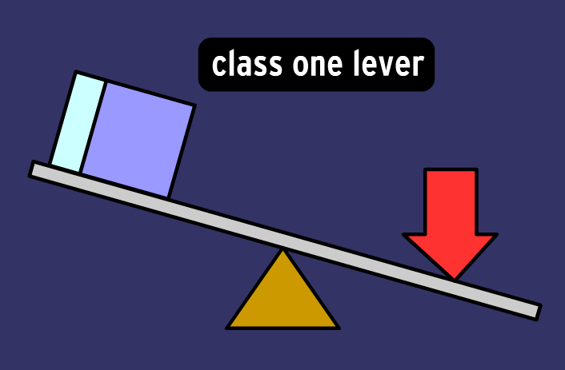
Levers have four parts:

Slide 4
1) The lever itself which is a length of relatively stiff material.

Slide 5
2) The fulcrum is the plane on which the lever balances or pivots.

Slide 6
3) The load is the weight or resistance which much be lifted or overcome.

Slide 7
4) The effort is the force that you apply to the lever.

Slide 8
A class one lever has the fulcrum between the load and the effort.

Slide 9
Load or resistance
Effort or force
Lever
Fulcrum

Slide 10
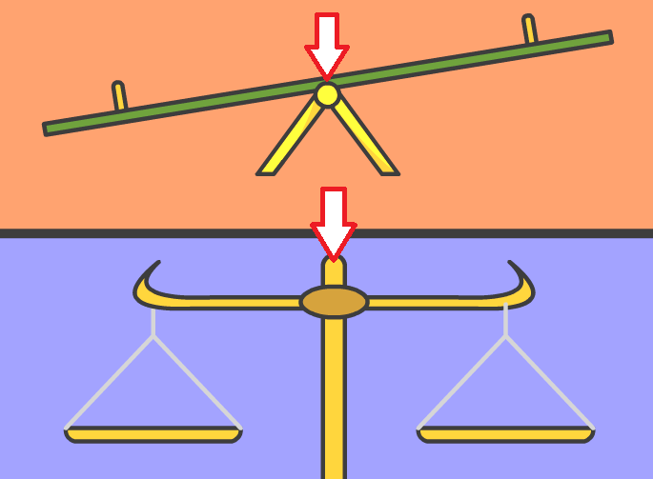
Y

Slide 11
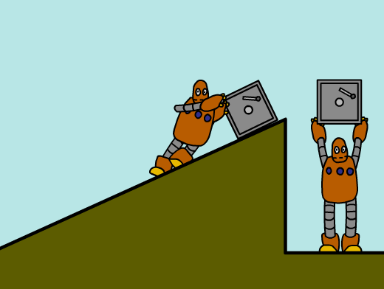
Distance and effort are interrelated. If you increase the distance over which you exert force, you can reduce the force exerted.

Slide 12
IIf I asked you to take 500 books to the library…

Slide 13
You could take 500 at one time with great force and less distance…..

Slide 14
Or you could carry one book at a time for great distance and less force

Slide 15
Work itself never changes, but you can adjust distance and effort. If you increase effort, distance decreases. If you decrease effort, distance increases.

Slide 16
Examples of First-class levers

Slide 18
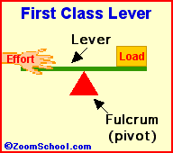

Slide 20
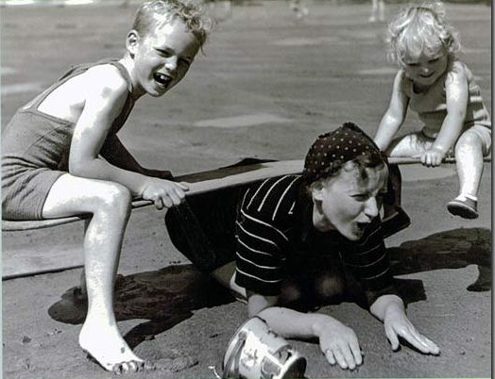

Slide 21
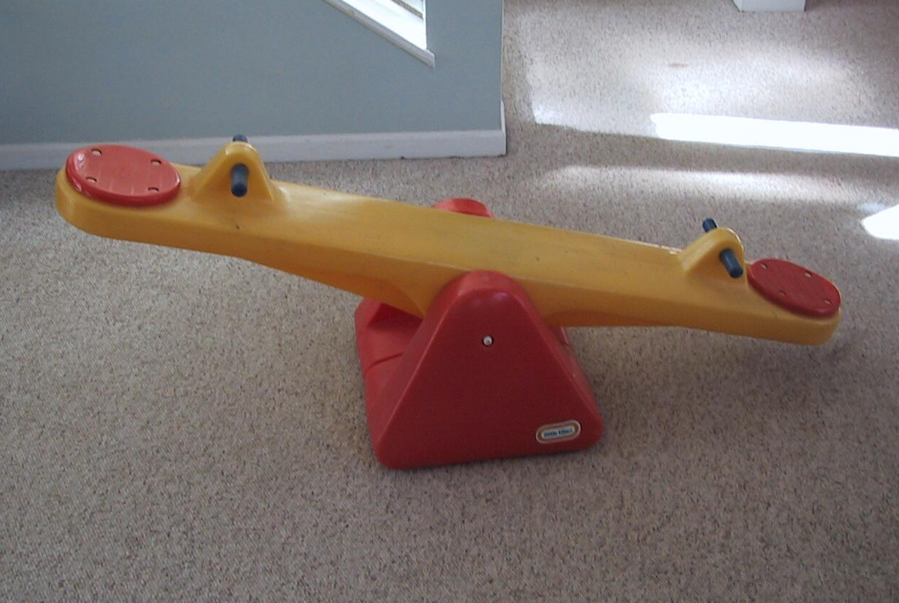

Slide 22
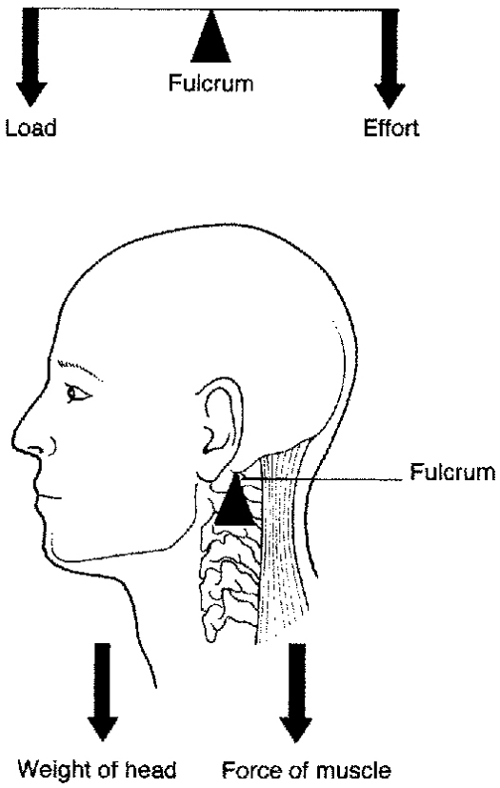

Slide 23
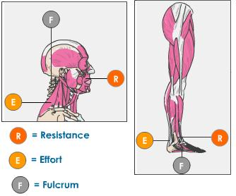

Slide 24
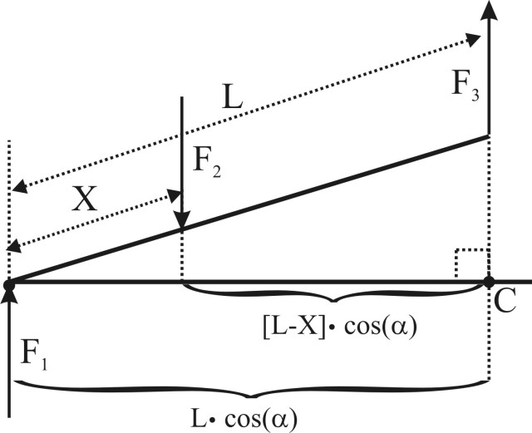
Levers

